Slide 1

HIGHLY PRIVILEGED & CONFIDENTIAL MATERIALS
REAL ESTATE MARKET – OVERVIEW
07th January 2019

Slide 2
contents
1
Real Estate Market Overview
2
GPL Story

Slide 3
Real Estate Market Overview – Pan India
Contributes ~6-7% to Indian’s GDP
Real estate industry is growing by CAGR of ~11 - 12% post FY18
Real Estate sector has undergone drastic changes in the past years
RERA implementation
Demonetization affecting developers and homebuyers
NBFC crisis leading to shortage in developer financing as well fund availability to home buyers
Change in GST structure
Stagnant market has lead to many stalled projects across geographies, with high level of unsold inventory
Sector is expected to see positive sentiments post government intervention of creating INR 25,000 Cr Alternate Investment Fund( AIF) , faster resolutions for stalled projects
Industry is seeing an inventory overhang of 34 months
Source : Prop Equity | * Data is collected till Oct’19 ( 7 months of FY 20)

Slide 4
Real Estate Market Absorption – Key Growth Region
BV in INR billion
Avg. value per unit in lacs
Source : Prop Equity | *Data has been collected till Oct’19 ( 7 months of FY20)

Slide 5
contents
1
Real Estate Market Overview
2
GPL Story

Slide 6
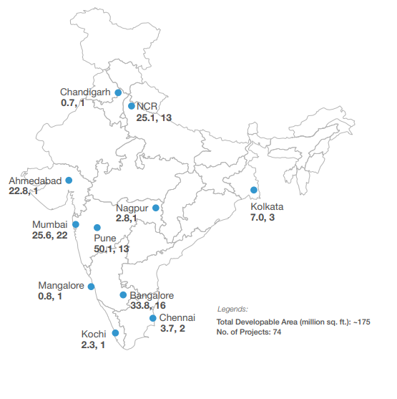
Godrej Properties Story
Established in 1990
India’s largest public sector developer by booking value over past 5 years
Successfully delivered over 20 million sq. ft. of real estate in past 5 years
~175 million sq. ft. of developable area across India
GPL has added ~31 million sq. ft. in FY 19. The projects are planned to be launched in FY 20 & FY 21 envisaging a stronger launch pipeline
GPL has strengthened its presence in four growth regions (MMR, NCR, Pune, Bengaluru) in the residential sector. ~134 million sq. ft. out of ~175 million sq. ft. (77%) developable area is in 4 growth regions
GPL booking value(BV) in FY 19 is INR 5,316 Cr. No of units sold in FY is ~6,900, resulting in average ticket size of INR 77 lacs
Current BV till H1 FY 20 is INR 2,343 Cr.

Slide 7
Godrej Performance – MMR, NCR
Launch Tracker for FY 20
Mumbai
Projects Launched: Nirvaan - Thane, Nest - Kandivali
Projects Expected: Vihaa - Badlapur, Godrej City- Panvel, RK studio – Chembur
NCR
Projects Launched: Palm Retreat, South Etstate,
Projects Expected: Sector 43, Golf Links, Meridian
Pune
Projects Launched: Godrej Hill side 1
Projects Expected: Godrej Hill side 2, Manjari 1, Nurture
Bengaluru
Projects Launched: Godrej 24, Godrej Lake Gardens
Projects Expected: Electronic city, Eternia, Devanahalli 2
BV for H1 FY 19 is INR 1,627 Cr
* For FY 20, data includes the performance till H1 FY20

Slide 8
GPL Home loan Share
GPL customer base: Current financier distribution
Value of homes financed by different institutions (INR crores)¹
Self funded
% of total
HDFC
27.5%
SBI
21.4%
45%
AXIS
11.7%
ICICI
9.4%
Distribution of loan providers is similar across both salaried and self-employed category
Indiabulls
152
5.7%
Bank funded
Other PSUs
7.5%
Other NBFCs²
6.4%
55⁴%
Other pvt banks³
2.8%
Cooperative Banks
0.3%
Yet to decide financier
7.3%
Total
2,660
100%
1 Value of Homes against which loan has been given: no data on LTV, exact disbursement numbers are unknown 2 Other NBFCs include PNBHFL, Bajaj Finance, Piramal, LIC, DHFL, Tata, ABFL, IIFHL, L&T Housing
3 Standard Chartered, Citi Bank, HSBC, Kotak Mahindra, Federal 4 Typical bank funding % achieved at the time of project completion

Slide 9
HIGHLY PRIVILEGED & CONFIDENTIAL MATERIALS
Thank You

