Slide 1

Day 3: Thursday, 9th Jan 2020
INDUCTION TRAINING - INSURANCE

Slide 2

Why the Why is important???

Slide 3

revenue

Slide 4
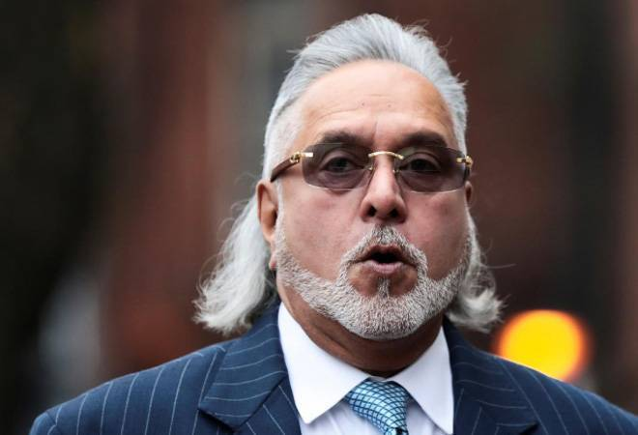
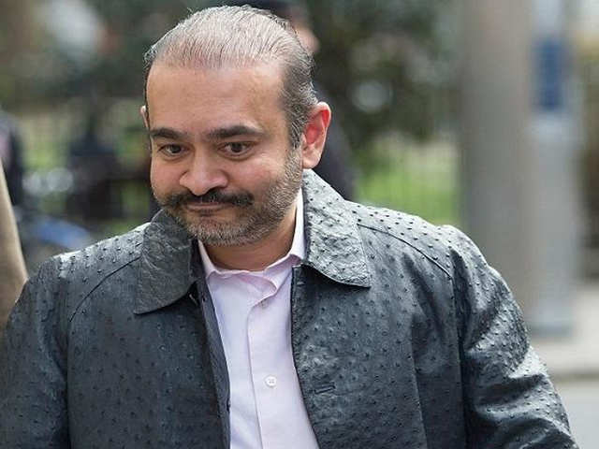
NPA customers

Slide 5

Reward and recognition

Slide 6


Slide 7
The godrej way….
GODREJ PROTECTION PROGRAM
Life Insurance Plan
Survival Benefit Plan
Health Insurance Plans

Slide 8

Life insurance plan – ABSLI Group asset assure classic
Natural Death
Accidental Death
Suicide (after 1 year)

Slide 9
Survival benefit plan – tata aig group credit secure plus
Critical Illness – coverage against 15 CI’s
PA – Accidental Death, Permanent Total Disability, Permanent Partial Disability
Add ON – Monthly EMI, Identity Theft, Fraudulent charges, ATM Assault & Robbery, Lost Wallet charges, Key replacement cover, House Alteration & Vehicle Modification benefit
Property Insurance – Standard Fire

Slide 10
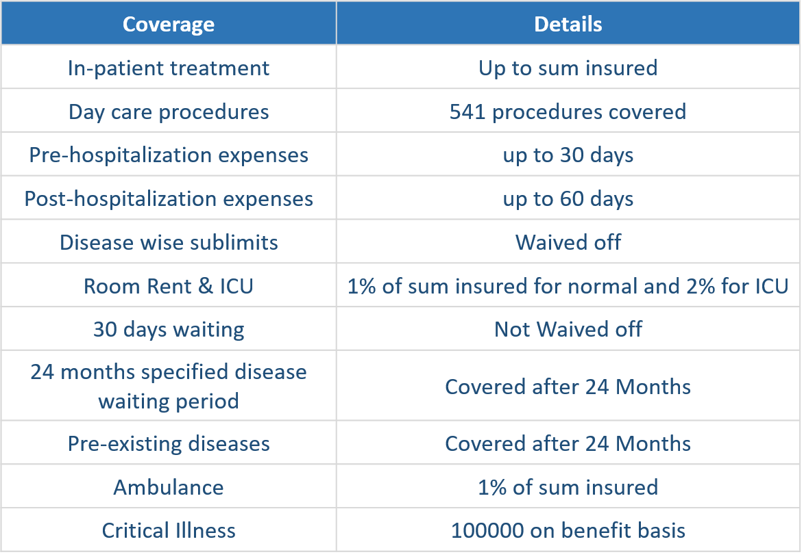

Health insurance plans – TATA AIG GROUP MEDICARE

Slide 11
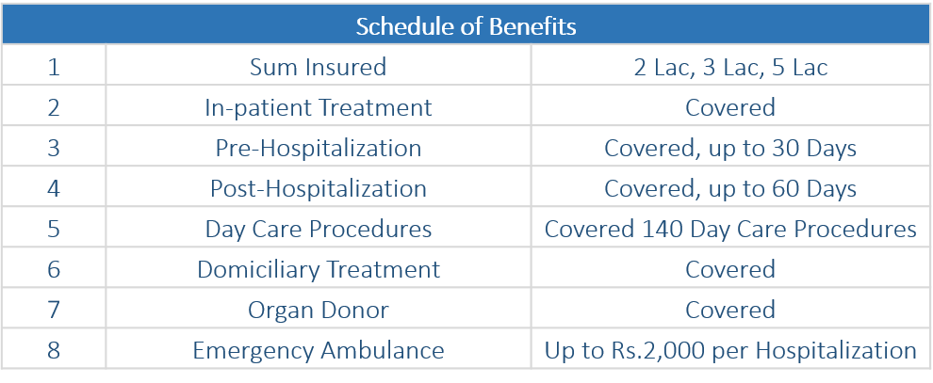

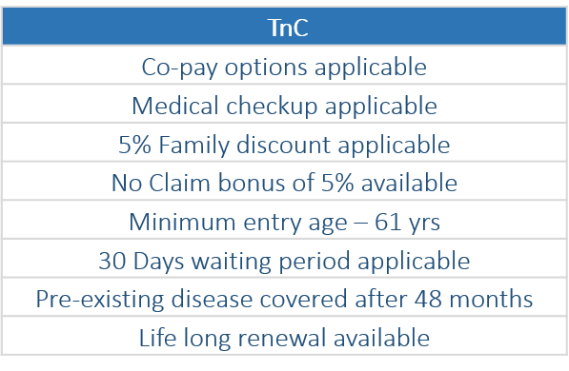
Health insurance plans – TATA AIG GROUP MEDisenior

Slide 12


